Slide 1

Info Challenge
DC Metro
MIDN 3/C Mallory, Nelson, Shuchman

Slide 2

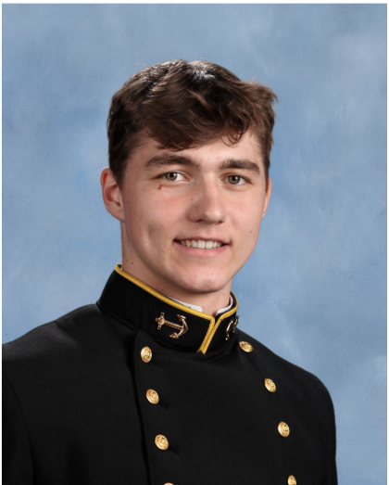
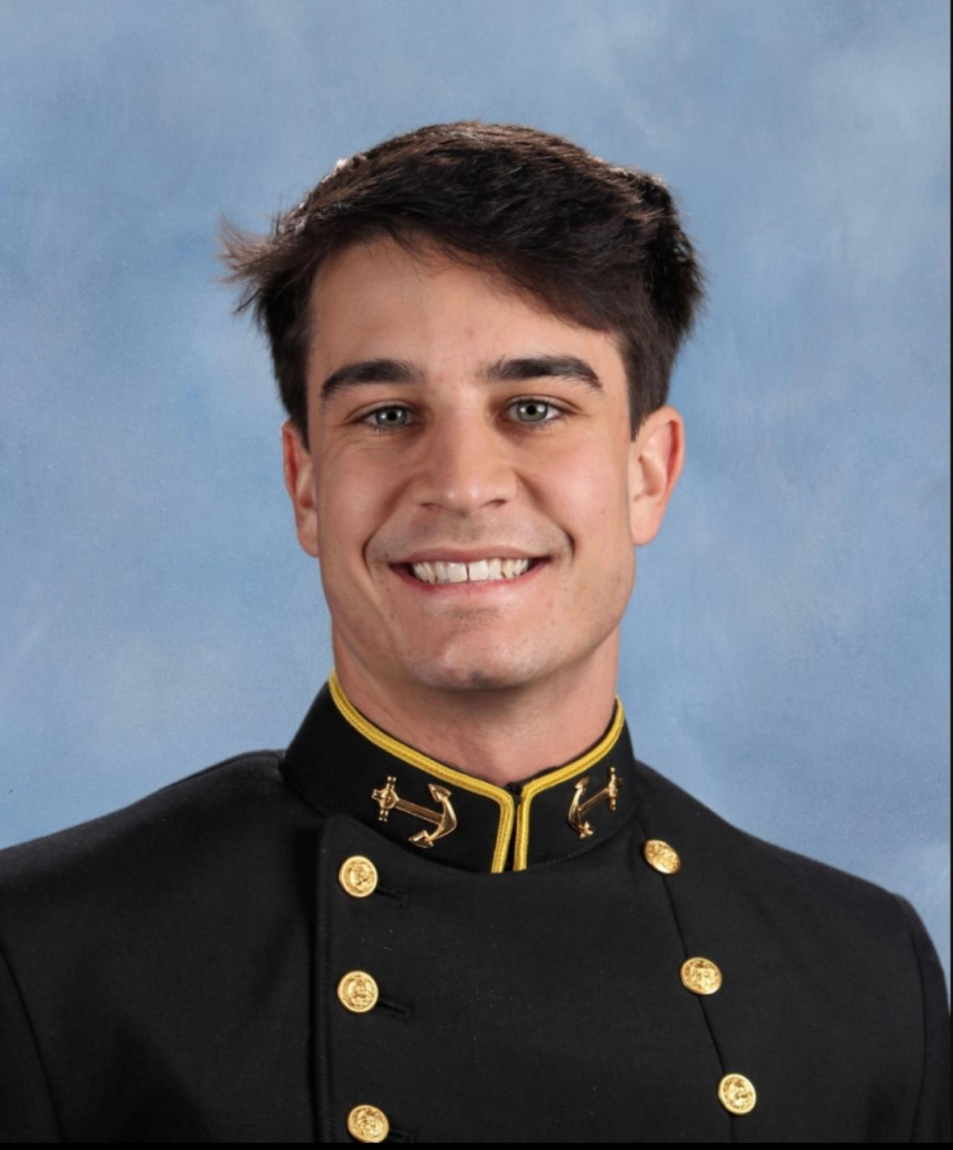
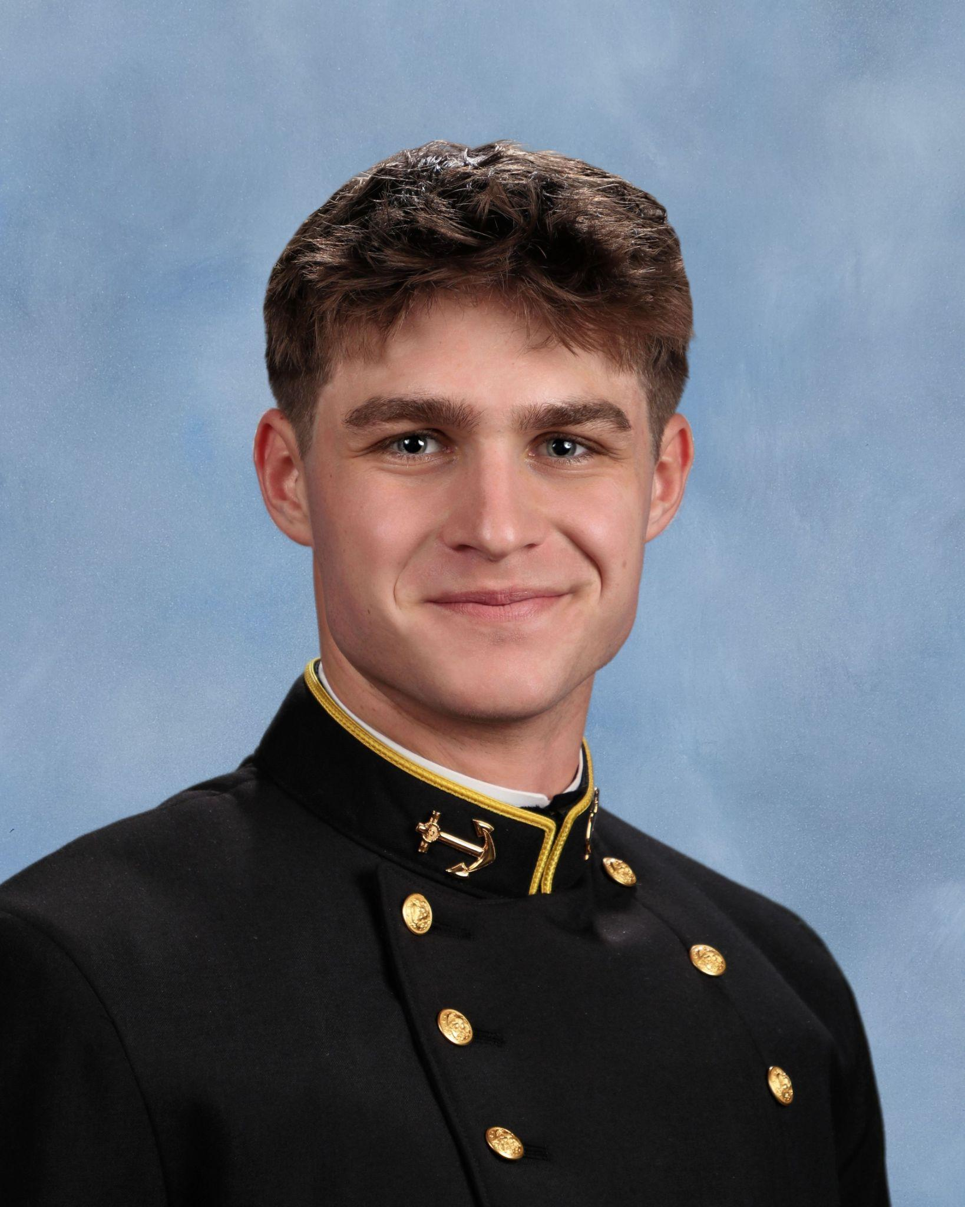
About us
Johnny Bio -
College: USNA
Hometown: Buffalo, NY
Sport/ECA: Intramural Basketball (Current Brigade 4th Place Associate Captain)
Dylan Bio -
College: USNA
Hometown: Virginia Beach
Sport/ECA: Club Baseball
Isaiah Shuchman -
College: USNA
Hometown: Philadelphia, PA
Sport/ECA: Heavyweight Rowing

Slide 3
Our Data Science Pipeline
Data Acquisition
Data Analysis
01
03
02
04
Data Processing
Data Visualization

Slide 4
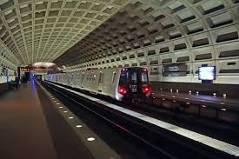
Our Problem
Popular Stations
Dupont, Foggy Bottom, Gallery Place, Navy Yard, Rosslyn, Tentley Town, Woodley Park (mostly used by college students or locals at these hours on weekends)
We set out to determine patterns of ridership during specific events/times. Our focus remained on Friday and Saturday nights when DC bar areas are packed. ]
We set out to create a metro pathway home for these individuals to get home with safer and cheaper options than uber or deciding to recklessly drive.
Entries (Evenings and Late Nights)
Comparing Entries at particular times to find the most potentially used paths.
Exits (Evenings and Late Nights)
Comparing Exits to reveal how stations could be used more at late nights.

Slide 5
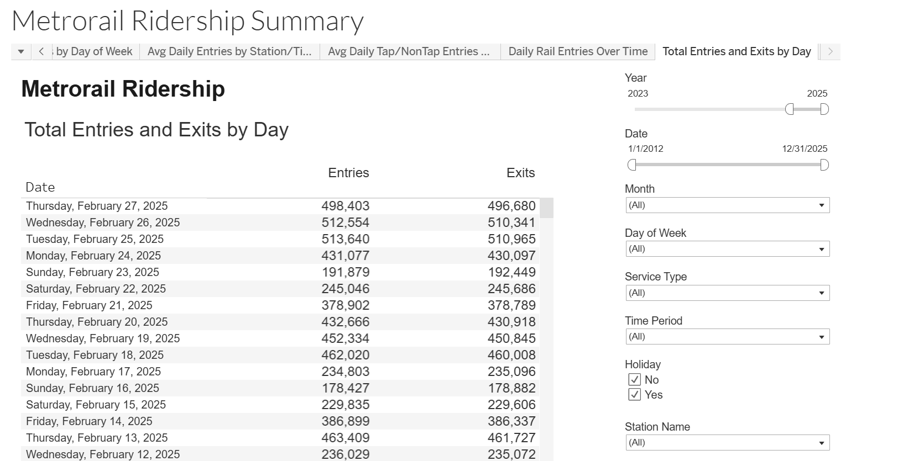
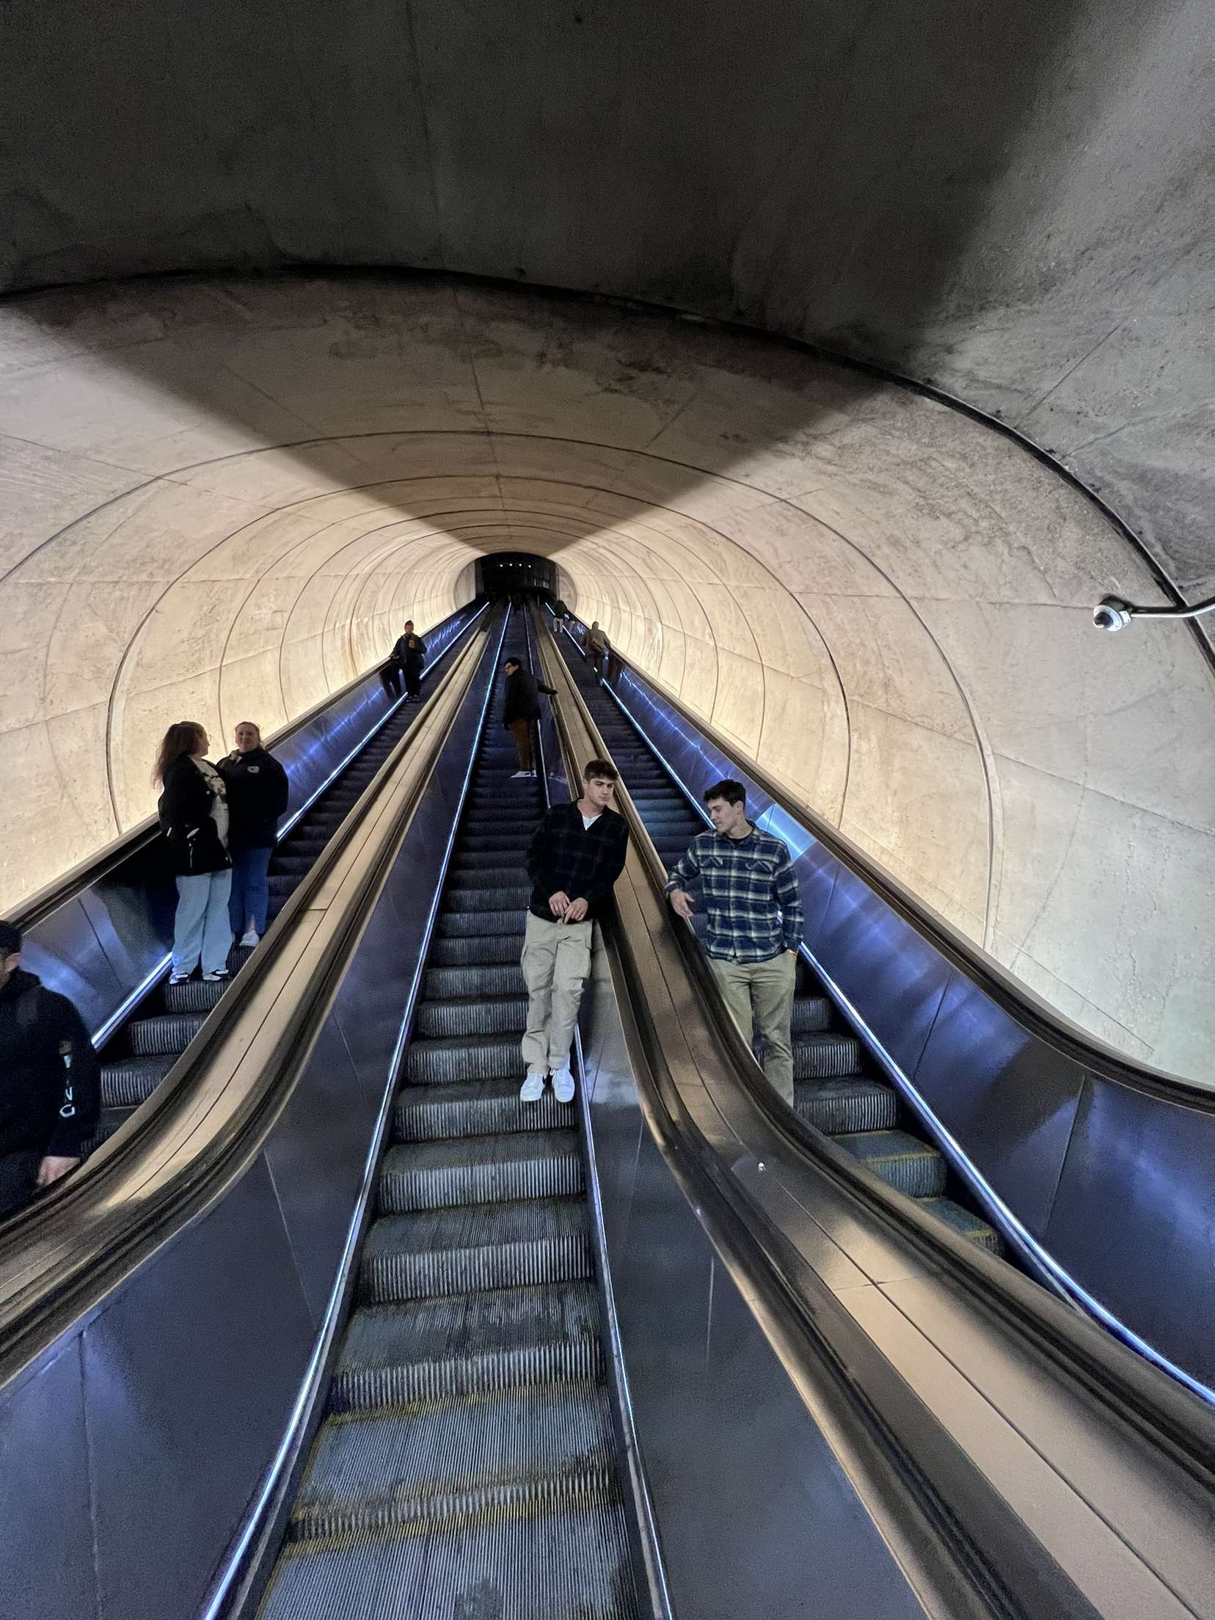
How we did it
Collect more data
Scrap
Downloaded and cleaned data on csv files.
We specified day of week (W, F, Sa), changed time periods, and checked each desired station to use as comparison.

Slide 6
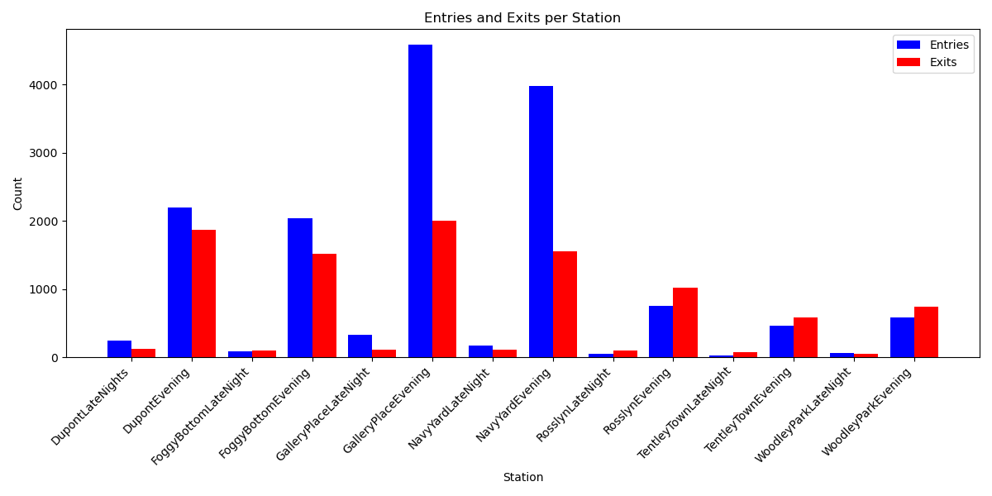
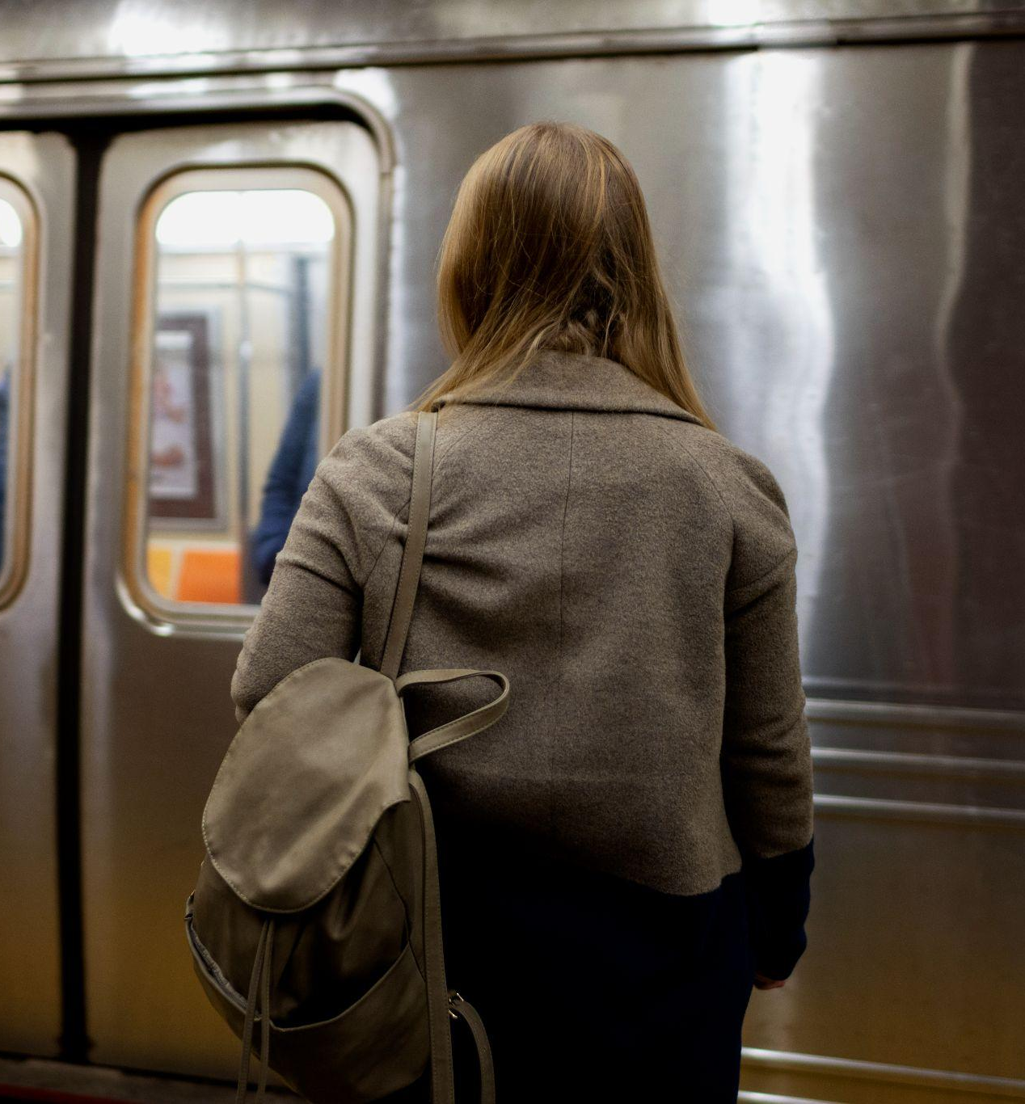
Don’t forget this
Do you know what helps you make your point clear? Lists like this one:
They’re simple
You can organize your ideas clearly
You’ll never forget to buy milk!
And the most important thing: the audience won’t miss the point of your presentation

Slide 7
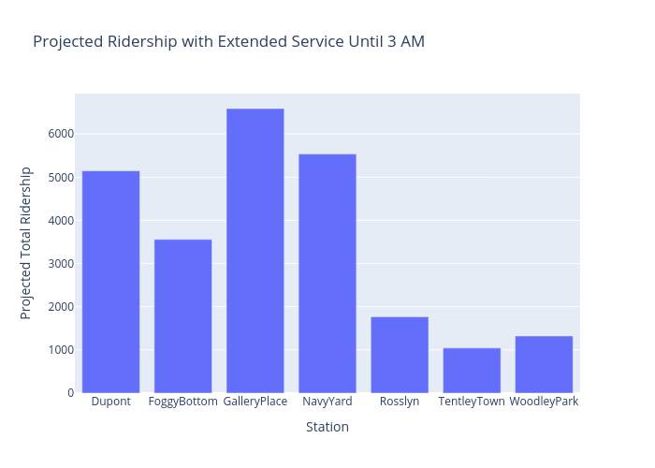
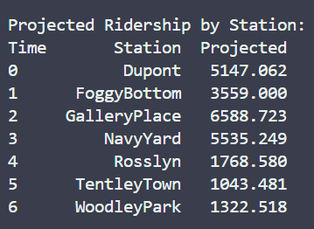
Ridership Projection
Determine projected ridership for each station type
Non-Nightlife:
Evening + Late Night = Projected
Nightlife:
Evening + 3(Late Night) = Projected

Slide 8
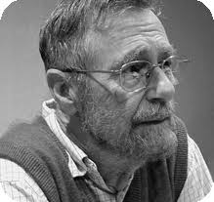
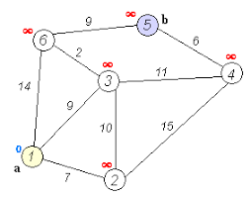
Edsger Dijkstra's algorithm
What it does?
Edsger W. Dijkstra
Find the shortest paths between nodes in a weighted graph, which may represent, for example, a road network
Edsger W. Dijkstra was a pioneering computer scientist whose work on algorithms and contributions to structured programming profoundly shaped the field of computer science.
How it applies
Allows us to look at different metro stops and create a new path that is more efficient

Slide 9
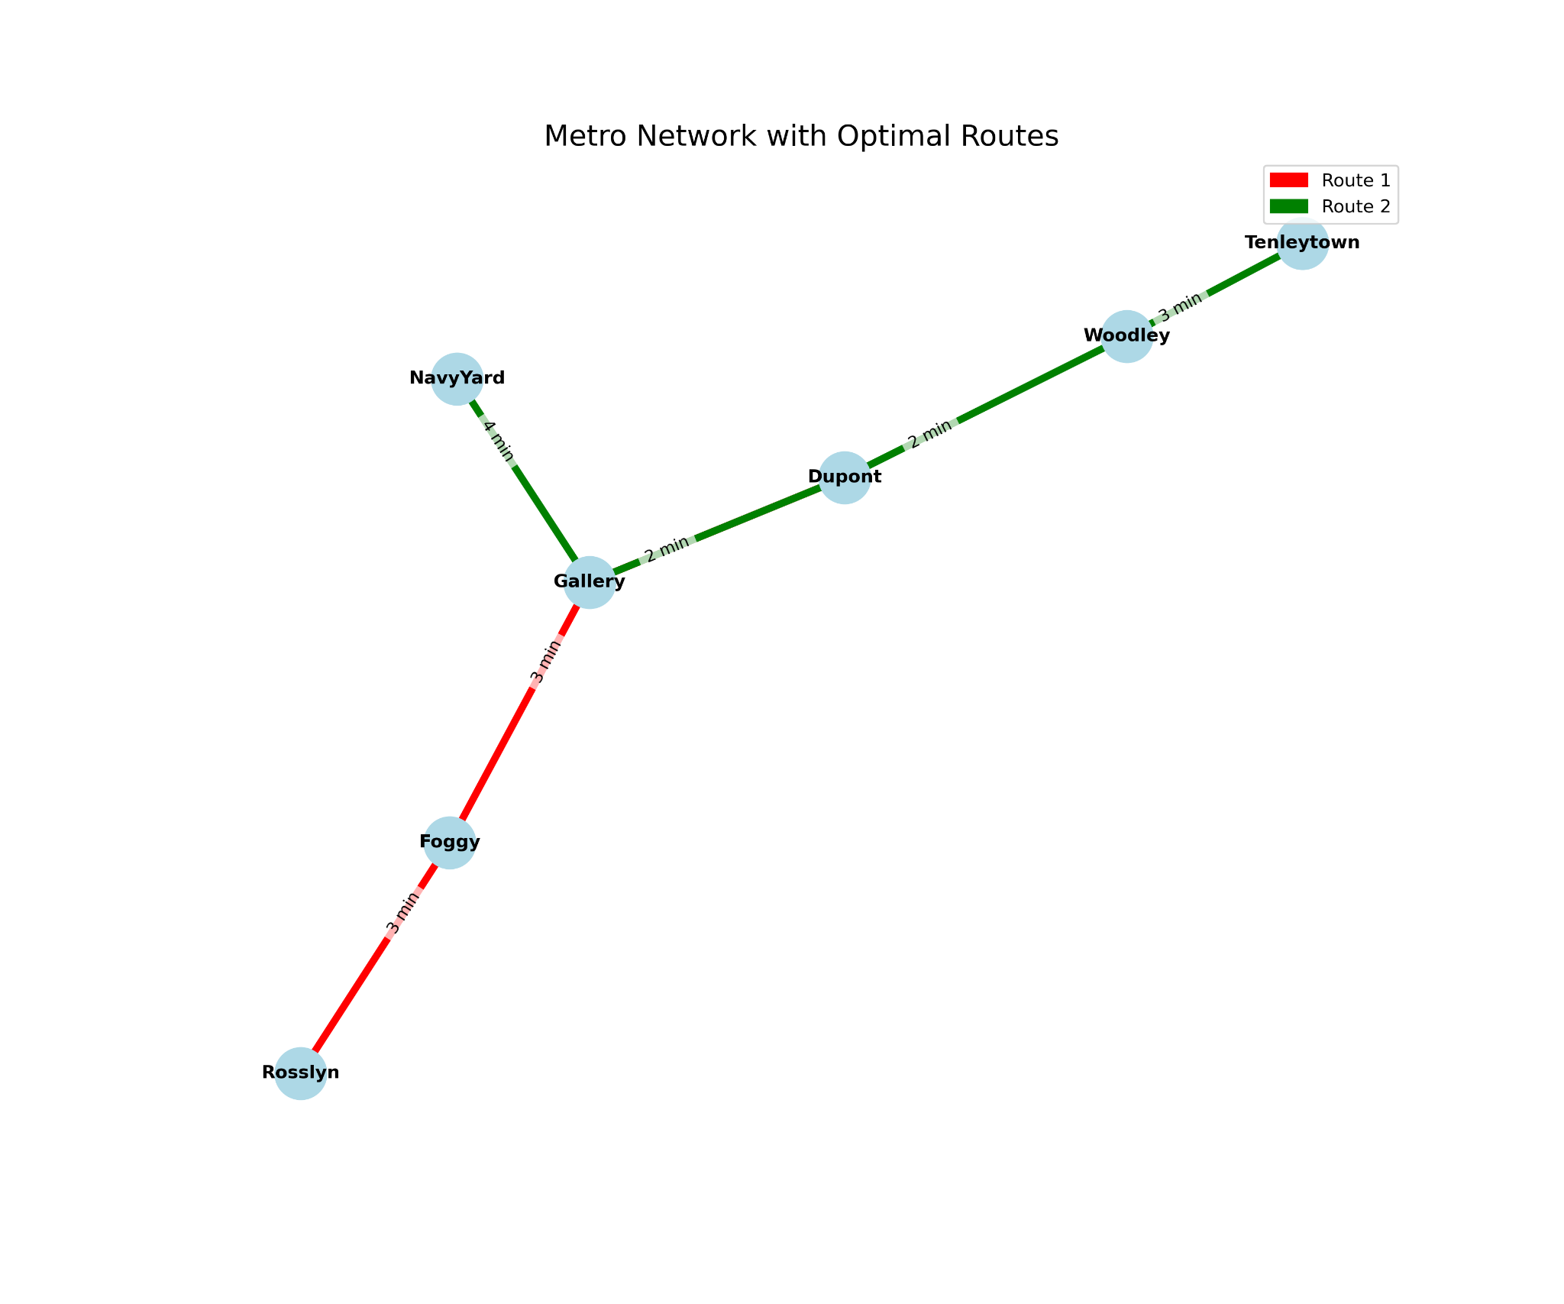
Our Algorithm
Graph Setup & Initialization:
Model transit stations as nodes and travel times as weighted edges; initialize the source node with a distance of zero and all other nodes with infinity.
Selection of the Nearest Node:
Iteratively choose the unvisited node with the smallest current distance from the source.
Edge Relaxation:
For the chosen node, update the distances of its neighbors if a shorter path is found through it, recording predecessors for path reconstruction.
Completion & Path Reconstruction:
Repeat until the target is reached (or all nodes are visited), then backtrack using the recorded predecessors to assemble the optimal route.

Slide 10
Case studies
Case 1 | The study also ranked D.C. in the top 5 worst drivers in the U.S. for 2024, with 54.6 driving incidents per 1,000 drivers.
Case 2 | A study ranked Washington, D.C. as having one of the highest DUI rates in the U.S., with 3.6 DUIs per 1,000 drivers.
Case 3 | In 2024, there were approximately 1 million DUI arrests in the United States, with alcohol-related crashes causing more than 13,000 deaths.

Slide 11
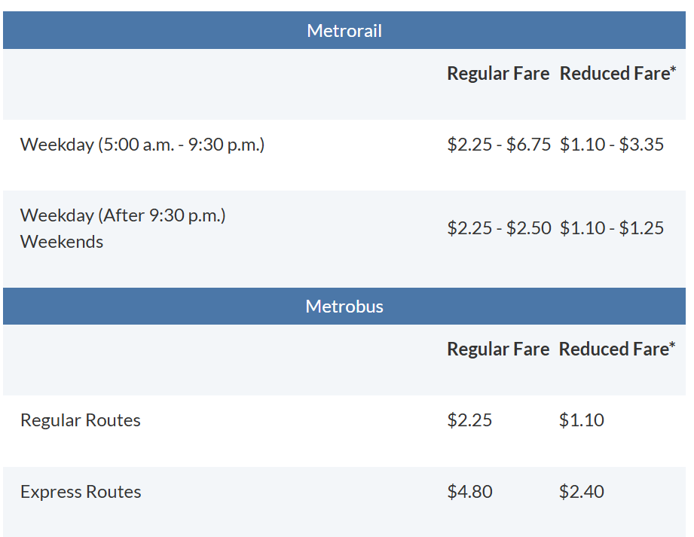
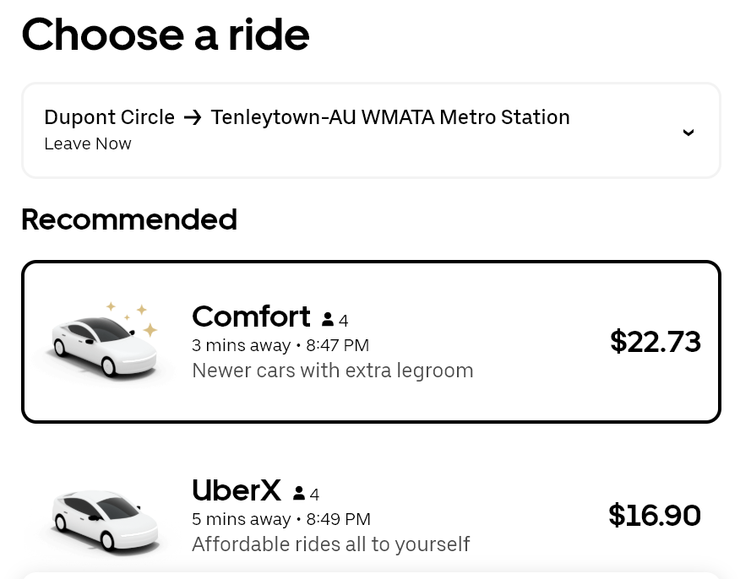
**90.1% Reduced Cost**
Price Comparison
Metro Prices Compared to Typical Uber Prices at Similar Distances

Slide 12
Marketing
Extending late-night Metrorail service would incur additional operational expenditures.
The potential economic benefits include increased tax revenue, job creation, and enhanced property values.
Expansion would stimulate significant growth in tourism by improving accessibility and enhancing the visitor experience.
Safe and reliable late-night transit options would likely boost participation in the city's nightlife economy, amplifying its overall economic impact.
For example, Gallery Place increases potential ridership from 4500 to 6500 for entries increases profit by about 44% . This ensures a comparison of the DC metro station bringing in an estimated $11,250 in the evening in contrast to a potential $16,250 by using our pathway we created using the Dijkstra algorithm.

Slide 13
8,000
$20,000
$1.04M
Additional Riders per average weekend night
Additional gross revenue per average weekend night
Additional gross revenue from one year of weekend service

Slide 14
Cost Assessment/Analysis
Running one subway car for an hour costs ~$250
3 cars per line and two lines brings overhead to $1500/hr
Per night costs are $4500
As the cars typically stop running at 1 AM, there would be no necessity in extra investment in more cars.
The extension of the DC metro running at late night would not increase taxes for VMATA.
However, there would be indirect tax revenue benefits since the economy would be stimulated due to easier access for individuals to participate in nightlife.
In addition to this, the increase in nightlife activity would attract more individuals from 20-30 to the DC area since it would improve DC’s reputation for low DUI rates and bring attention to more events in the region.

Slide 15
Citations
https://www.wmata.com/initiatives/ridership-portal/Metrorail-Ridership-Summary.cfm
https://plotly.com/python-api-reference/
https://networkx.org/documentation/stable/reference/index.html
https://pandas.pydata.org/docs/
https://matplotlib.org/stable/index.html
https://docs.python.org/3/library/os.path.html
https://www.marketplace.org/2019/04/11/subways-us-expensive-cost-comparison/
Chat GPT (Open AI) – was used for troubleshooting code syntax and understanding theory

Slide 16
Thank you!

